Slide 1
Applied Machine Learning SEZG568/SSZG568
Dr Y V K RAVI KUMAR
yvk.ravikumar@pilani.bits-pilani.ac.in

Slide 2
Session 6(26th August,2023)

Slide 3
Session 6 – 26th August,2023
5 | Classification Models I: Naïve Bayes classification, Applications in text and image classification | T2: Chapter 5

Slide 8
Classification
Definition
Given a collection of records (training set )
Each record is by characterized by a tuple (x,y), where x is the attribute (feature) set and y is the class label
x aka attribute, predictor, independent variable, input
Y aka class, response, dependent variable, output
Task
Learn a model or function that maps each attribute set x into one of the predefined class labels y
Task | Attribute set, x | Class label, y
Categorizing email messages | Features extracted from email message header and content | spam or non-spam
Identifying tumor cells | Features extracted from x-rays or MRI scans | malignant or benign cells
Cataloging galaxies | Features extracted from telescope images | Elliptical, spiral, or irregular-shaped galaxies

Slide 9
General Approach for Building Classification Model

Slide 10
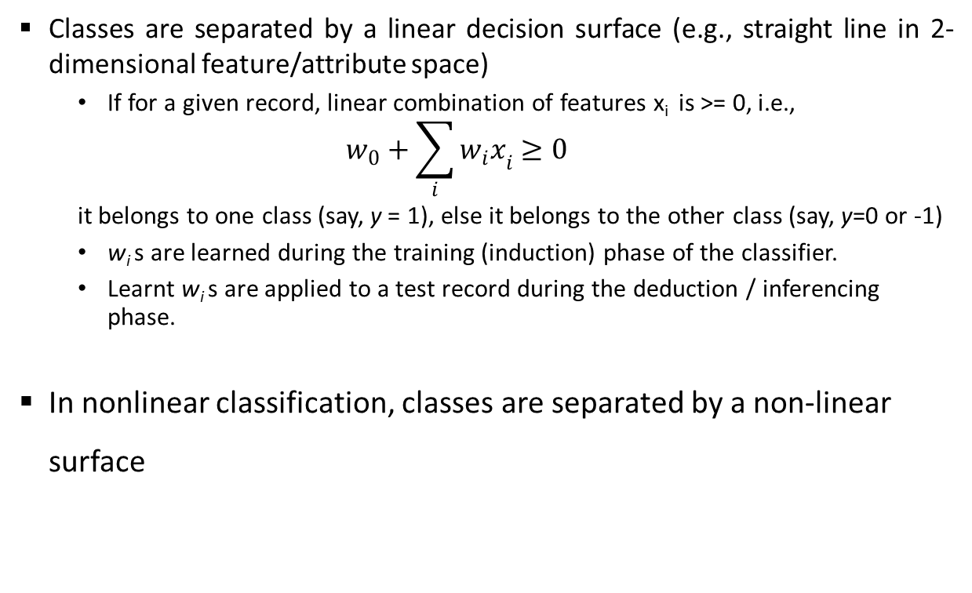
Types of Classifiers
Linear Classifier
Classes are separated by a linear decision surface (e.g., straight line in 2-dimensional feature/attribute space)
If for a given record, linear combination of features x_{i} is >= 0, i.e.,
$$w_{0}+\sum_{i}{{w_{i}x}_{i}≥0}$$
it belongs to one class (say, y = 1), else it belongs to the other class (say, y=0 or -1)
w_{i} s are learned during the training (induction) phase of the classifier.
Learnt w_{i} s are applied to a test record during the deduction / inferencing phase.
In nonlinear classification, classes are separated by a non-linear surface
y=1
x₂
Decision Boundary
y=0
x₁

Slide 11
Generative Vs. Discriminative Models
Generative
Generative Model
Class-conditional probability distribution of attribute/feature set and prior probability of classes are learnt during the training phase
Given these learnt probabilities, during inferencing phase, probability of a test record belonging to different classes are calculated and compared.
Can result in linear or nonlinear decision surface
x₂
x₁
Discriminative
Discriminative Model
y=1
Given a training set, a function f is learnt that directly maps an attribute/feature vector x to the output class (y=1 or 0/-1)
A linear function f results in linear decision surface
x₂
Decision Boundary
y=0
x₁

Slide 12
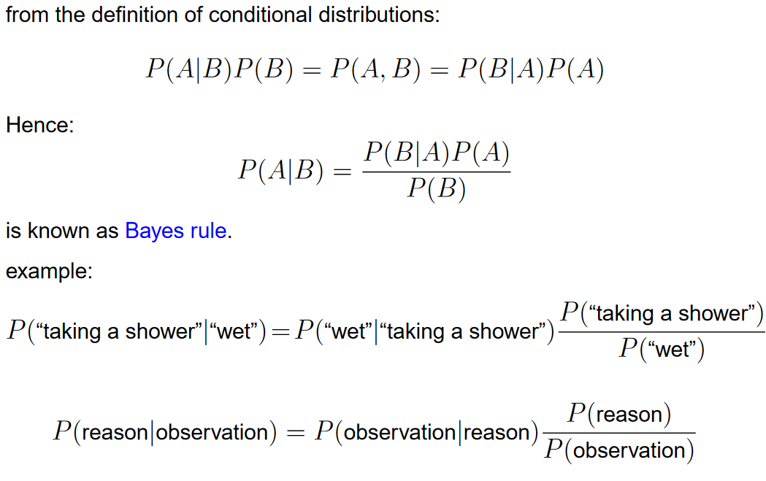
Bayes Rule

Slide 13
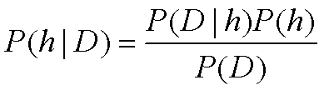
Bayes Theorem
P(h) = prior probability of hypothesis h
P(D) = prior probability of training data D
P(h|D) = probability of h given D
P(D|h) = probability of D given h

Slide 14
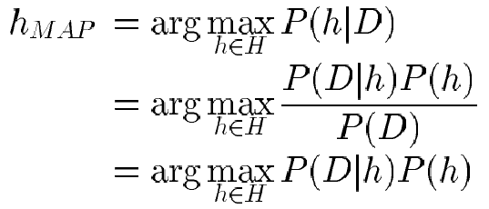
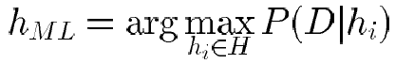
Choosing Hypotheses
Generally want the most probable hypothesis given the training data
Maximum a posteriori hypothesis h_{MAP}:
If assume P(h_{i}) = P(h_{j}) then can further simplify, and choose the Maximum likelihood (ML) hypothesis

Slide 15
Example
Consider a medical diagnosis problem in which there are two alternative hypotheses:
H1:That a patient has a particular form of cancer
H2:That the patient does not
The available data is from a particular laboratory test with two possible outcomes
+ Positive
- Negative

Slide 16
Over the entire population of people only 0.008 have this disease. The test returns a corrective positive result in only 98% of the cases in which the disease is actually present and a correct negative result in only 97% of the cases in which the disease is not present.

Slide 24
Using Bayes Theorem for Classification
Consider each attribute and class label as random variables
Given a record with attributes (X₁, X₂,…, X_{d})
Goal is to predict class Y (“Evade”)
given (X₁,X₂,X₃)=(<Refund>, <Marital Status>, <Taxable Income>)
Specifically, we want to find the value of Y that maximizes P(Y| X₁, X₂,…, X_{d} )
Can we estimate P(Y| X₁, X₂,…, X_{d} ) directly from data?

Slide 25
Using Bayes Theorem for Classification
Approach
Compute posterior probability P(Y | X₁, X₂, …, X_{d}) using the Bayes theorem
Maximum a-posteriori: Choose Y that maximizes P(Y | X₁, X₂, …, X_{d})
Equivalent to choosing value of Y that maximizes P(X₁, X₂, …, X_{d}|Y) P(Y)
How to estimate P(X₁, X₂, …, X_{d} | Y )?

Slide 26
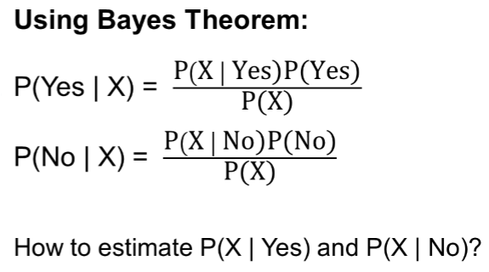
Example Data
Given a Test Record

Slide 27
Naïve Bayes on Example Data
Given a Test Record
P(X | Yes) =
P(Refund = No | Yes) x
P(Divorced | Yes) x
P(Income = 120K | Yes)
P(X | No) =
P(Refund = No | No) x
P(Divorced | No) x
P(Income = 120K | No)

Slide 28
Estimate Probabilities from Data
Discrete Attributes
P(y) = fraction of instances of class y
e.g., P(No) = 7/10, P(Yes) = 3/10
For categorical attributes P(X_{i} =c | y) = n_{c} / n
n_{c} is number of instances having attribute value X_{i} =c and belonging to class y
e.g., P(Status=Married|y=No) = 4/7,
P(Refund=Yes|y=Yes)=0

Slide 29
Example of Naïve Bayes Classifier
Given a Test Record
P(Refund = Yes | No) = 3/7
P(Refund = No | No) = 4/7
P(Refund = Yes | Yes) = 0
P(Refund = No | Yes) = 1
P(Marital Status = Single | No) = 2/7
P(Marital Status = Divorced | No) = 1/7
P(Marital Status = Married | No) = 4/7
P(Marital Status = Single | Yes) = 2/3
P(Marital Status = Divorced | Yes) = 1/3
P(Marital Status = Married | Yes) = 0
For Taxable Income:
If class = No: sample mean = 110
sample variance = 2975
If class = Yes: sample mean = 90
sample variance = 25
P(X | No) = P(Refund=No | No) × P(Divorced | No) × P(Income=120K | No) = 4/7 × 1/7 × 0.0072 = 0.0006
P(X | Yes) = P(Refund=No | Yes) × P(Divorced | Yes) × P(Income=120K | Yes) = 1 × 1/3 × 1.2 × 10⁻⁹ = 4 × 10⁻¹⁰
P(X|No)P(No) > P(X|Yes)P(Yes)
Therefore, P(No|X) > P(Yes|X) => Class = No

Slide 30
S. No | Outlook | Temp | Humidity | Windy | Play Tennis
1 | Rainy | Hot | High | False | No
2 | Rainy | Hot | High | True | No
3 | Overcast | Hot | High | False | Yes
4 | Sunny | Mild | High | False | Yes
5 | Sunny | Cool | Normal | False | Yes
6 | Sunny | Cool | Normal | True | No
7 | Overcast | Cool | Normal | True | Yes
8 | Rainy | Mild | High | False | No
9 | Rainy | Cool | Normal | False | Yes
10 | Sunny | Mild | Normal | False | Yes
11 | Rainy | Mild | Normal | True | Yes
12 | Overcast | Mild | High | True | Yes
13 | Overcast | Hot | Normal | False | Yes
14 | Sunny | Mild | High | True | No

Slide 31
today = (Sunny, Hot, Normal, False)

Slide 32
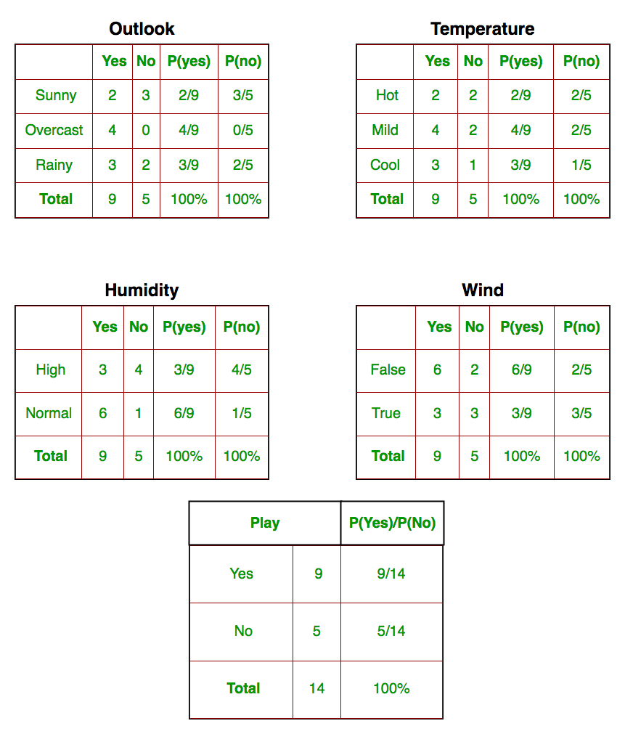

Slide 33
New Instance: Magazine Promotion = Yes , Watch Promotion = Yes, Life Insurance Promotion = No, Credit Card Insurance = No then Sex = ?
Magazine Promotion | Watch Promotion | Life Insurance Promotion | Credit Card Insurance | Sex
Yes | No | No | No | Male
Yes | Yes | Yes | Yes | Female
No | No | No | No | Male
Yes | Yes | Yes | Yes | Male
Yes | No | Yes | No | Female
No | No | No | No | Female
Yes | Yes | Yes | Yes | Male
No | No | No | No | Male
Yes | No | No | No | Male
Yes | Yes | Yes | No | Female

Slide 38
Example 4
A: attributes
M: mammals
N: non-mammals
P(A|M)P(M) > P(A|N)P(N)
=> Mammals

Slide 39
Issues with Naïve Bayes Classifier
Consider the table with Tid = 7 deleted
Naïve Bayes Classifier:
P(Refund = Yes | No) = 2/6
P(Refund = No | No) = 4/6
P(Refund = Yes | Yes) = 0
P(Refund = No | Yes) = 1
P(Marital Status = Single | No) = 2/6
P(Marital Status = Divorced | No) = 0
P(Marital Status = Married | No) = 4/6
P(Marital Status = Single | Yes) = 2/3
P(Marital Status = Divorced | Yes) = 1/3
P(Marital Status = Married | Yes) = 0/3
For Taxable Income:
If class = No: sample mean = 91
sample variance = 685
If class = No: sample mean = 90
sample variance = 25
Given X = (Refund = Yes, Divorced, 120K)
P(X | No) = 2/6 X 0 X 0.0083 = 0
P(X | Yes) = 0 X 1/3 X 1.2 X 10⁻⁹ = 0
Naïve Bayes will not be able to classify X as Yes or No!

Slide 40
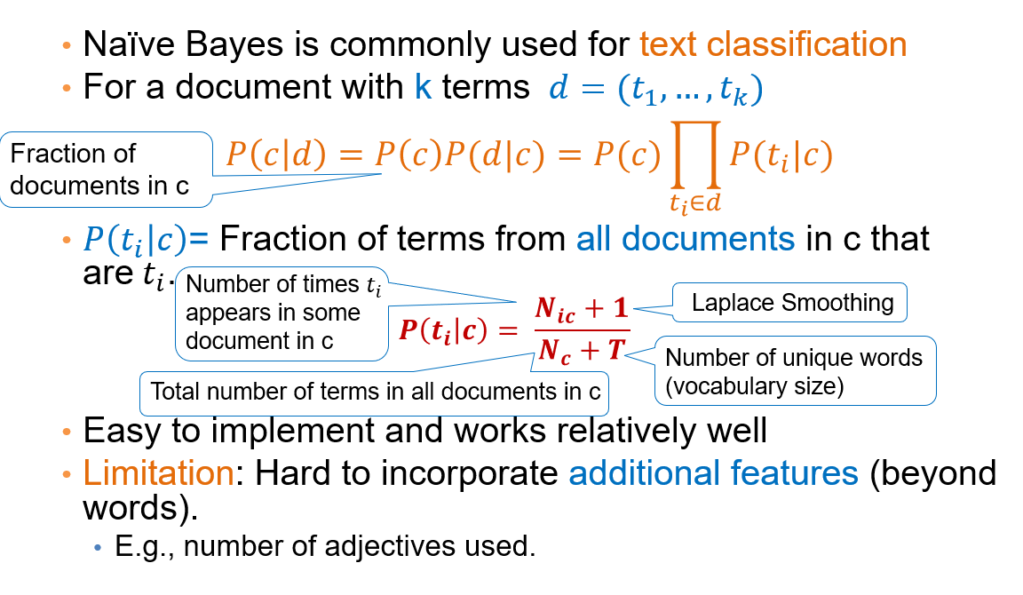

Slide 41
A Simple Example
Which tag does the sentence A very close game belong to? i.e. P(sports| A very close game)
Text | Tag
“A great game” | Sports
“The election was over” | Not sports
“Very clean match” | Sports
“A clean but forgettable game” | Sports
“It was a close election” | Not sports
Feature Engineering: Bag of words i.e use word frequencies without considering order
Using Bayes Theorem:
P(sports| A very close game)
= P(A very close game| sports) P(sports)
----------------------------------------------
P(A very close game)
We assume that every word in a sentence is independent of the other ones
“close” doesn’t appear in sentences of sports tag, So P(close | sports) = 0, which makes product 0

Slide 42
Laplace smoothing
Laplace smoothing: we add 1 or in general constant k to every count so it’s never zero.
To balance this, we add the number of possible words to the divisor, so the division will never be greater than 1
In our case, the possible words are ['a', 'great', 'very', 'over', 'it', 'but', 'game', 'election', 'clean', 'close', 'the', 'was', 'forgettable', 'match'].

Slide 43
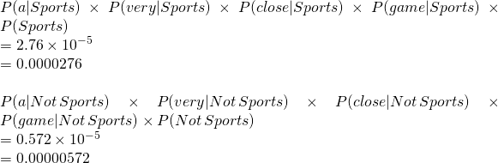
Apply Laplace Smoothing
Word | P(word | Sports) | P(word | Not Sports)
a | 2+1 / 11+14 | 1+1 / 9+14
very | 1+1 / 11+14 | 0+1 / 9+14
close | 0+1 / 11+14 | 1+1 / 9+14
game | 2+1 / 11+14 | 0+1 / 9+14

Slide 44
Example
Doc No | Text
1 | I LOVED THE MOVIE
2 | I HATED THE MOVIE
3 | A GREAT MOVIE ,GOOD MOVIE
4 | POOR ACTING
5 | GREAT ACTING , A GOOD MOVIE
NEW | I HATED THE POOR ACTING

Slide 45
Example
Doc No | Text
1 | I LOVED THE MOVIE _POSITIVE
2 | I HATED THE MOVIE _ NEGATIVE
3 | A GREAT MOVIE ,GOOD MOVIE _POSITIVE
4 | POOR ACTING _NEGATIVE
5 | GREAT ACTING , A GOOD MOVIE _POSITIVE
NEW | I HATED THE POOR ACTING _????

Slide 51
1 | This is my book | Statement
2 | They are novels | Statement
3 | Have you read this book | Question
4 | Who is the author | Question
5 | What are the characters | Question
6 | This is how I bought the book | Statement
7 | I like fictions | Statement
8 | What is your favourite book | Question

Slide 64
Logistic regression
Logistic Regression could help use predict, for example, whether the student passed or failed. Logistic regression predictions are discrete (only specific values or categories are allowed). We can also view probability scores underlying the model’s classifications.
In comparison, Linear Regression could help us predict the student’s test score on a scale of 0 - 100. Linear regression predictions are continuous (numbers in a range).
Takes a probabilistic approach for learning discriminative functions
Idea
Naïve Bayes allows computing P(Y|X) by learning P(Y) and P(X|Y)
Why not learn P(Y|X) directly?

Slide 65
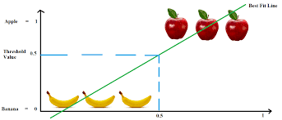
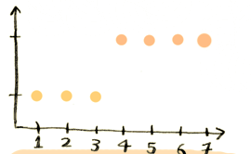
Logistic regression
Similarly, when you are trying to classify something, first you plot your data on a graph.
Suppose you are trying to classify a new piece of fruit as an apple or a banana. Here's your existing data:
Banana
Apple
Fruit length in inches
i.e. anything that is less than 4 inches in length is an apple, anything greater than that is a banana.

Slide 66
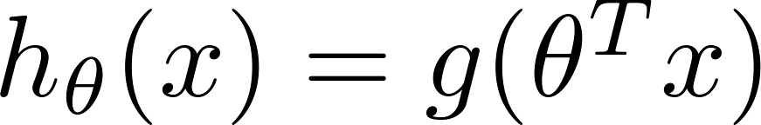
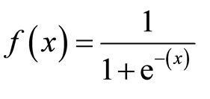
Logistic regression
Remember, the prediction function for logistic regression spits out a percentage.
As in "we are 95% sure this is a Banana".
The g(...) is called the sigmoid function.
This function is what makes the prediction function output a percentage.
The sigmoid function constrains the result to between 0 and 1.
So a result of .95 would mean we are 95% certain of something.
That's all you really need to know about the sigmoid function.
The sigmoid function is:
where, x = y_hat

Slide 67
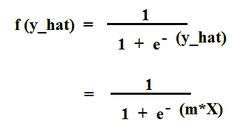
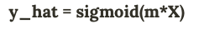
Sigmoid/Logistic Function
Hence, the equation becomes:
So, the final hypothesis for Logistic Regression becomes:

Slide 68

Sigmoid/Logistic Function
Classification requires discrete output values
For example, output y = 0 or 1 for a two-category classification problem
In logistic regression, sigmoid/logistic function h_{ɵ}(x) takes a real vector x as input and outputs a value between 0 and 1
ɵ is a vector of logistic regression parameters
$$h_{θ}\left(x\right)=\frac{1}{1+e^{−θ^{⊤}x}}$$
$$g(z)$$
$$z$$

Slide 69
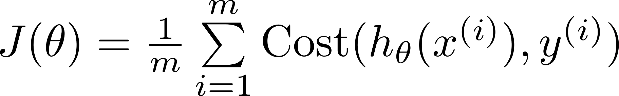
Cost function for Logistic Regression
Cross Entropy or Log Loss Function
$$if y=1$$
$$Cost(h_{θ}\left(x\right),y)=\left\{\begin{aligned}−log\left(h_{θ}\left(x\right)\right) if y=1 \\ −log\left({1−h}_{θ}\left(x\right)\right) if y=0\end{aligned}\right.$$
$$0$$
$$h_{θ}\left(x\right)$$
$$1$$
$Cost\left(h_{θ}\left(x\right),y\right)=−y log\left(h_{θ}\left(x\right)\right)−(1−y)$ $log\left({1−h}_{θ}\left(x\right)\right)$
$$if y=0$$
J(θ) is convex
Apply gradient descent on J(θ) w.r.t. θ to find optimal parameters
$$h_{θ}\left(x\right)$$
$$1$$
$$0$$

Slide 70
Gradient descent
$$J\left(θ\right)=−\frac{1}{m}\left[\sum_{i=1}^{m}{y^{(i)} log\left(h_{θ}\left(x^{(i)}\right)\right)+(1−y^{(i)}) log\left({1−h}_{θ}\left(x^{(i)}\right)\right)}\right]$$
Goal: $\min_{θ}{J(θ)}$
Repeat {
$$θ_{j}≔θ_{j}−α\frac{∂}{∂θ_{j}}J\left(θ\right)$$
}
Good news: Convex function!
Bad news: No analytical solution
(Simultaneously update all $θ_{j}$)
$$\frac{∂}{∂θ_{j}}J\left(θ\right)=\frac{1}{m}\sum_{i=1}^{m}{(h_{θ}\left(x^{\left(i\right)}\right)−y^{(i)})}x_{j}^{(i)}$$

Slide 71
Logistic Regression Applications
Credit Card Fraud : Predicting if a given credit card transaction is fraud or not
Health : Predicting if a given mass of tissue is benign or malignant
Marketing : Predicting if a given user will buy an insurance product or not
Banking : Predicting if a customer will default on a loan.

Slide 72
Thank You!

